Slide 1
VECTOR SPACE MODEL
Paulami Das
IBAB-IIITB Bigdata ,
Bangalore

Slide 2
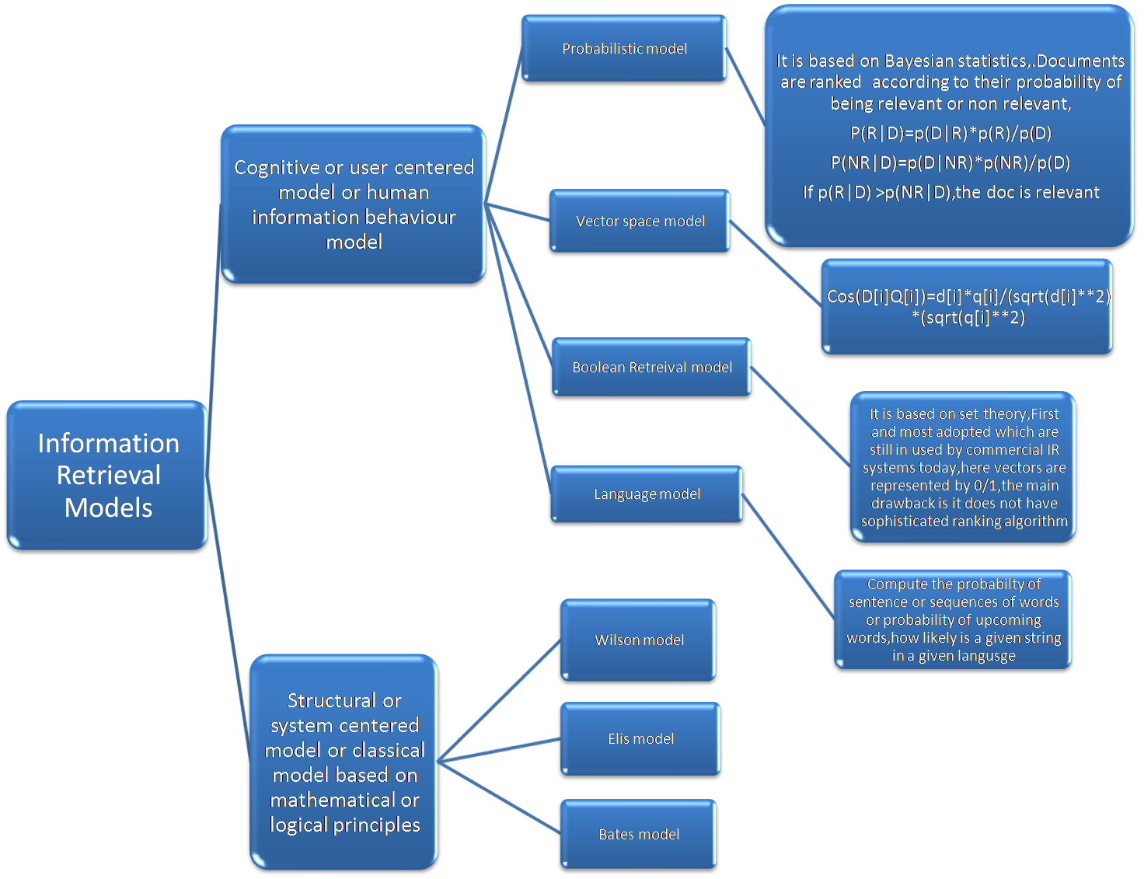
.

Slide 3
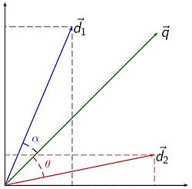
WHAT IS VECTOR SPACE MODEL:
Another name is Term Vector Model or Vector Processing
It represents both docs and queries by term sets and compare global similarities between query and documents
It was first used by SMART information Retrieval System
Used to compare different texts and relevant records similar to the queries
Terms are single words/key words or phrases
The dimentionality of the vector is the no of words in te vocabulary
A text can be represented by the words it contains
Bag of Words representation
It is used in NLP,information retrieval and Document similarity
It is used to determine which doc is more similar to a given query
Documents and queries are represented in a same space
Formula’s:
i and j are two documents ,k – term and t- last term
T
∑ Term[ik] (the sum of weight of all properties of a vector)
k=1
T
∑Term[ik].Term[jk] (the sum of product of term weights for two vector)
k=1
T
∑min(Term[ik],Term[jk]) (minimum of the sum of prodt of term weights for two vector
k=1

Slide 4
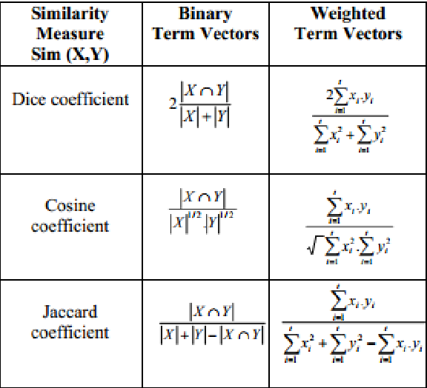
Similarity coefficient
Calculation of Jacard Coefficient
Calculation of Dice Coefficient
Sim(doci,docj)=
2 x [∑Tk=1 Termik*Termjk)]/T∑k=1Termik+T∑k=1Termjk
Doci=[3,2,10,0,0,1,1]
Docj=[1,1,1,0,01,0,0]
2x[(3x1)+(2x1)+(1x1)+(0x0)+(0x0)+(0x1)+(1x0)+(1x0)]/(3+2+1+0+0+0+1+1)+(1+1+1+0+0+1+0+0)
=12/12=1
Sim(doci,docj)=
∑Tk=1 (Termik*Termjk)/T∑k=1Termik+T∑k=1Termjk+(T∑k=1Termik-T∑k=1Termjk)
Doci=[3,2,10,0,0,1,1]
Docj=[1,1,1,0,01,0,0]
6/8+4-6 =6/6 =1

Slide 5
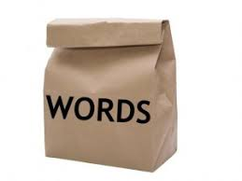
BAG OF WORDS MODEL It is a puppy .it is cute
Text preprocessing for modelling,Text are generating from different types of source
Take full set of documents what you want to quantify
Filtering out the stop words(most common word which does not contain relevant information like SO,WHO,OR,A,AN,THE and then take the remaining token
TOKENIZATION:break out every single element into a corpus,so that we can have a look at them,
Stem and lemmitizing it to get the root words
word | Freq counts
they | 0
puppy | 1
and | 1
cat | 0
good | 0
cute | 1
… | …

Slide 6
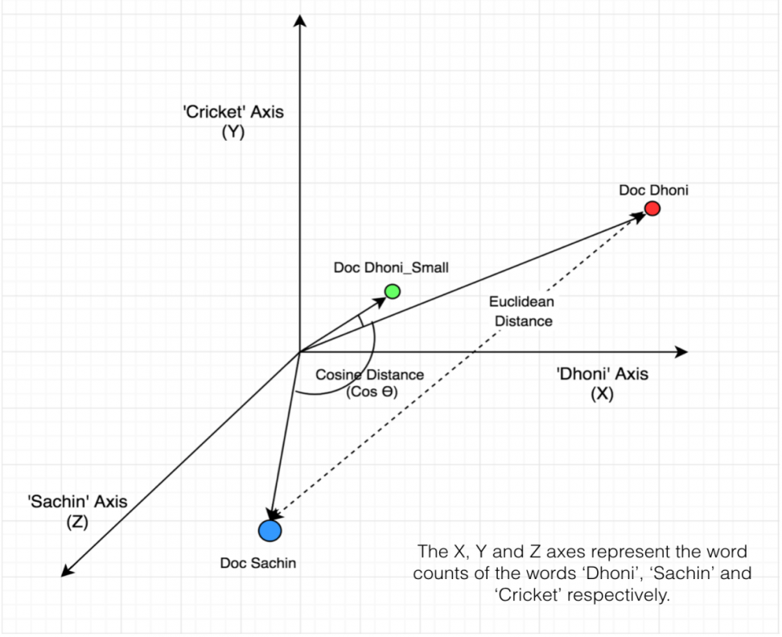
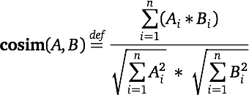
Cosine Similarities
To measure the similarities between documents irespecively of their sizes
Mathematically it measures the cosine of the angle between two vectors projecting in a multidimentional space
The angle between two vectors or rather than cosine of that angle is used as a proxy for the similarity of the documents
Smallar angle means larger similarity
As the range of cosα=[-1,1],but text count cant be negetive,so the range is [0,1]

Slide 7
Contd..
Document 1: IBAB has bigdata course for biology
Document 2: learning biology is easy
Document 3: bigdata is a vast subject
query: bigdata biology
 | IBAB | learning | has | bigdata | course | for | biology | is | a | vast | subject | easy
doc1 | 1 | 0 | 1 | 1 | 1 | 1 | 1 | 0 | 0 | 0 | 0 | 0
doc2 | 0 | 1 | 0 | 0 | 0 | 0 | 1 | 1 | 0 | 0 | 0 | 1
doc3 | 0 | 0 | 0 | 1 | 0 | 0 | 0 | 1 | 1 | 1 | 1 | 0
query | 0 | 0 | 0 | 1 | 0 | 0 | 1 | 0 | 0 | 0 | 0 | 0
Cossim(doc1,query)=((1x1)+(1x1))/2.44 =0.81
Cossim(doc2,query)=1/3.74=0.26
Cossim(doc3,query)=1/3.74=0.26 as we see doc1 is our relevant docs

Slide 8
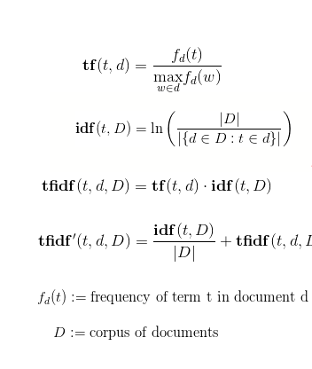
Tf-idf Model
Term Frequency also known (TF) measures the number of times word w occurs in a document/total number of words in a documents.
Inverse Document Frequency (IDF) measures log ( no of documents /no of docs that contaains word w)
In information retrieval, tf–idf or TFIDF is a numerical statistic that is intended to reflect how important a word is to a document in a collection or corpus.
It is often used as a weighting factor in searches
of information retrieval, text mining, and user modeling.
tf–idf is one of the most popular termweighting
schemes today; 83% of text-based recommender systems
in digital libraries use tf–idf.
Variations of the tf–idf weighting scheme are often used
by search engines(google) as a central tool in scoring and
ranking a document's relevance given a user query.
tf–idf can be successfully used for stop-words filtering
in various subject fields, including text summarization
and classification.
One of the simplest ranking functions
(page rank algorithm)is computed
by summing the tf–idf for each query term.
TF–PDF (Term Frequency * Proportional Document Frequency).
TF–PDF was introduced in 2001 in the context of identifying emerging topics in the media. The PDF component measures the difference of how often a term occurs in different domains.
Another derivate is TF–IDuF. In TF–IDuF,idf is not calculated based on the document corpus that is to be searched or recommended. Instead, idf is calculated on users' personal document collections. The authors report that TF–IDuF was equally effective as tf–idf but could also be applied in situations when, e.g., a user modeling system has no access to a global document corpus.

Slide 9
Contd..
Document 1: IBAB has bigdata course for biology
Document 2: learning biology is easy
Document 3: bigdata is a vast subject
query: bigdata biology
Normalised TF for all the documents: TF=(NO OF TIMES WORD APPEAR IN A DOCS/NO OF WORDS IN A DOCS)
docs | learning | biology | IBAB | has | bigdata | course | for | easy | is | a | subject | vast
Doc1 | 0 | 1/6=0.16 | 1/6=0.16 | 1/6=0.16 | 1/6=0.16 | 1/6=0.16 | 1/6=0.16 | 0 | 0 | 0 | 0 | 0
Doc2 | ¼=0.25 | ¼=0.25 | 0 | 0 | 0 | 0 | 0 | ¼=0.25 | ¼=0.25 | 0 | 0 | 0
Doc3 | 0 | 0 | 0 | 0 | 1/5=0.2 | 0 | 0 | 0 | 1/5=0.2 | 1/5=0.2 | 1/5=0.2 | 1/5=0.2
IDF: log(no of docs/no of docs that contains query word)

Slide 10
learning | biology | IBAB | has | bigdata | course | for | easy | is | a | subject | vast
Log(3/1)=0.477 | log(3/2)=0.17 | Log(3/1)=0.477 | Log(3/1)=0.477 | Log(3/2)=0.17 | Log(3/1)=0.477 | Log(3/1)=0.477 | Log(3/1)=0.477 | Log(3/2)=0.17 | Log(3/1)=0.477 | Log(3/1)=0.477 | Log(3/1)=0.477
Calculation of TF x IDF ,to fond out relevant doc for the query:bigdata biology:
query | doc1 | doc2 | doc3
bigdata | 0.17*0.16=0.0272 | 0.17*0=0 | 0.17*0=0
biology | 0.17*0.16 | 0.17*0=0 | 0.17*0=0
Thus we can say that doc1 is relevant to the query

Slide 11
Pros and Cons of VSM:
Pros.
Allows documents with partial match to be also identified
The cosine formula gives u a score which can be used to order documents
If two documents are far apart by Euclidean distance due to huge size of a particular documents, Chances are still there as they may still be oriented closer together , as it captures the orientation of the documents not the magnitude
Cons
As documents are treated as Bag of words model so no positional information will be there
It lacks the guidance of details of how weighting and ranking algo are related to relevance

Slide 12
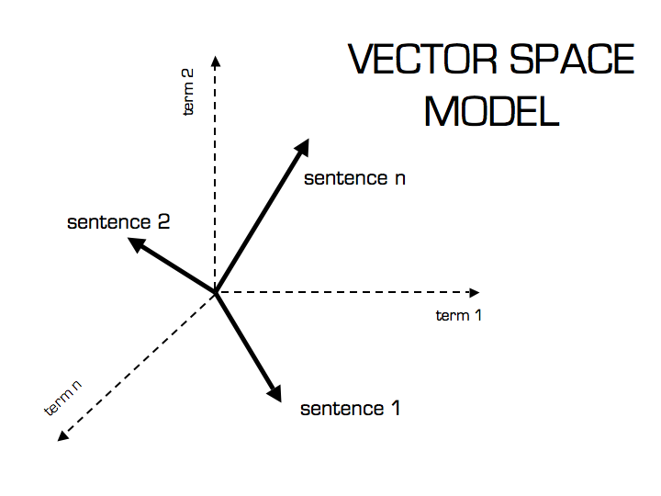
Application of VSM in BioInformatics
DNA sequence searching
Particular gene which is highly up regulated or downregulated in some RNA sequence (by counting the frequency of that gene sequences)
PSSM
Sequence encoding using term document matrix
Clustering
Database search
Pattern classification
Sequence alignment
Finding consensus sequence

Slide 13
Implementation in python
https://github.com/PAUL-8274/seminar_on_vector_space_model

Slide 14
Reference:
www.machinelearningplus.com
Vector Space Information Retrieval Techniques for Bioinformatics Data Mining Eric Sakk and Iyanuoluwa E. Odebode Department of Computer Science, Morgan State University, Baltimore, MD USA
https://janav.wordpress.com/2013/10/27/tf-idf-and-cosine-similarity/
https://pdfs.semanticscholar.org/eb1e/5b5e264e34b0fdd786b064208581e36c6cc5.pdf
http://bscit.berkeley.edu/cgi-bin/pl_dochome?query_src=&format=html&collection=Wilensky_papers&id=3&show_doc=yes
http://lucene.apache.org/core/3_6_1/api/all/org/apache/lucene/search/Similarity.html
http://scikit-learn.org/stable/modules/generated/sklearn.feature_extraction.text.TfidfTransformer.html#sklearn.feature_extraction.text.TfidfTransformer
https://www.opinosis-analytics.com/knowledge-base/what-is-term-frequency/

Slide 15
THANK YOU

